Slide 1
Automate Snake Xenzia using classing planning algorithm
Group-23
Nishant Verma-2020CSB1103
Raj-2020CSB1116
Ishaan Chhabra - 2020MCB1238

Slide 2
RRT/RRT*
Rapidly-exploring random trees (RRTs)
RRTs are used to plan a path for a robot or other agent to move from one point to another in a complex environment.
The algorithm starts by creating a root node at the robot's current position. Then, it randomly samples a point in the environment and extends the tree towards that point. If the extension intersects with an obstacle, it is stopped. Otherwise, a new node is created at the end of the extension and added to the tree.
RRT* is a modified version of RRT that is designed to find asymptotically optimal paths.

Slide 3
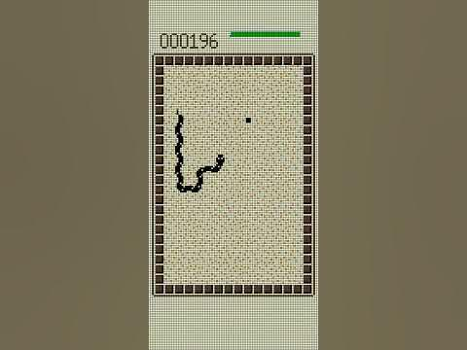
Why use this in Snake Xenzia?
The Snake Xenzia game is a challenging planning problem. The snake has to move through a complex environment without colliding with itself or the walls. RRT and RRT* are well-suited for solving challenging planning problems because they can deal with non-holonomic constraints and obstacles.
RRT and RRT are relatively easy to implement.* This makes them a good choice for use in games, where performance is often a critical factor.
Using RRT and RRT in the Snake Xenzia game can be a fun and educational experience.* It can help players to learn about planning algorithms and how they can be used to solve real-world problems.

Slide 4
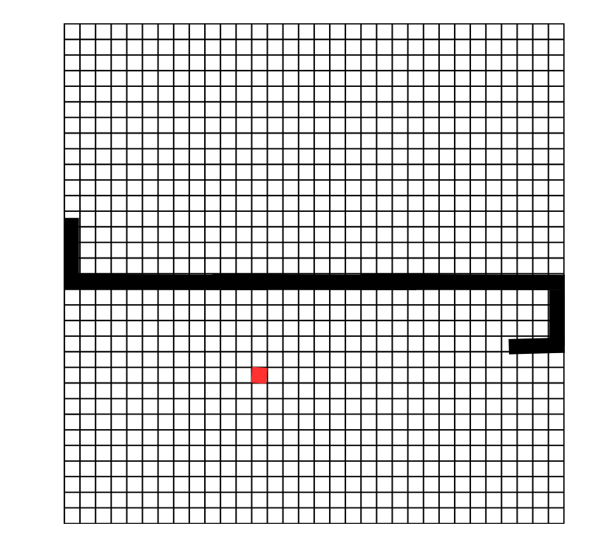
Research Gap
In case of a dynamic environment, the planned path may become invalid due to the changes in the environment. This requires our algorithm to replan frequently, which can be computationally expensive.

Slide 5
Game space
The game space is represented as a rectangular shaped matrix, where each element of the matrix represents a location on the game board.
The fruit position is represented as a single coordinate in the game space.
The snake's body is represented as a list of cubes, where each cube represents a part of the snake's body. Each cube has its own position, direction, and other properties.
The game ends when the snake collides with itself or the walls of the game board.

Slide 6
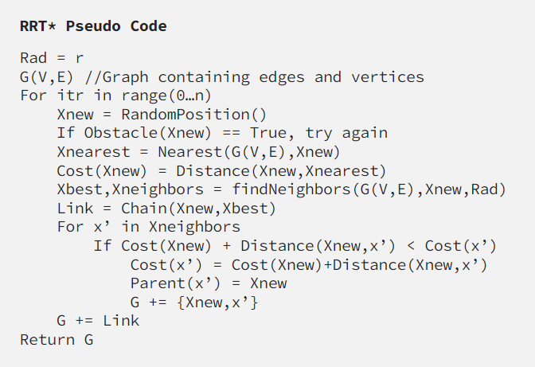
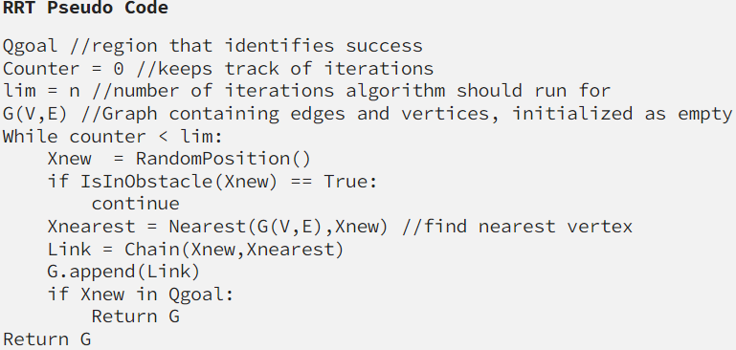

Slide 7
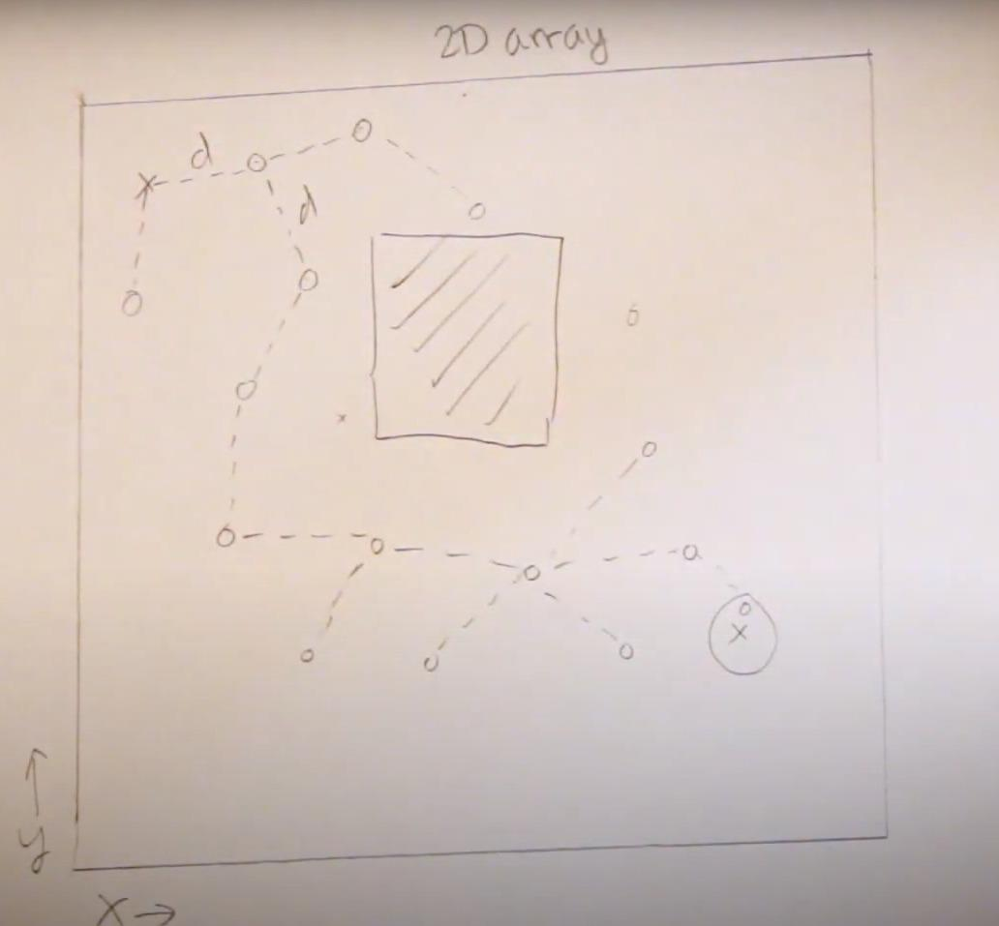
Generate random points in the game space?
We uniformly generated random points towards the goal node using a uniform distribution.
Other probabilistic distributions could be used to generate points for the next node.

Slide 8
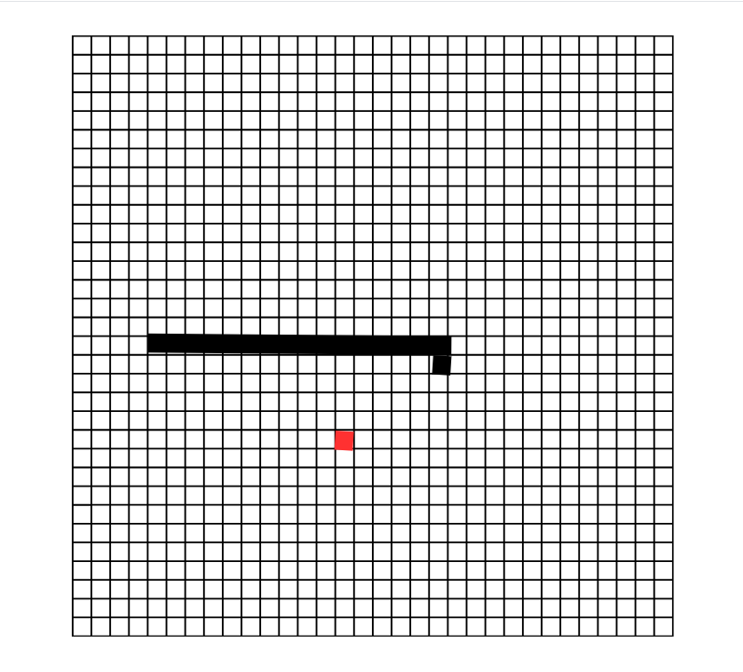
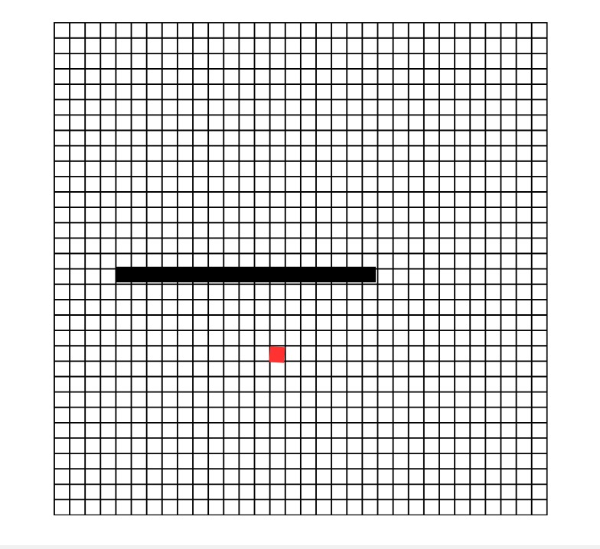
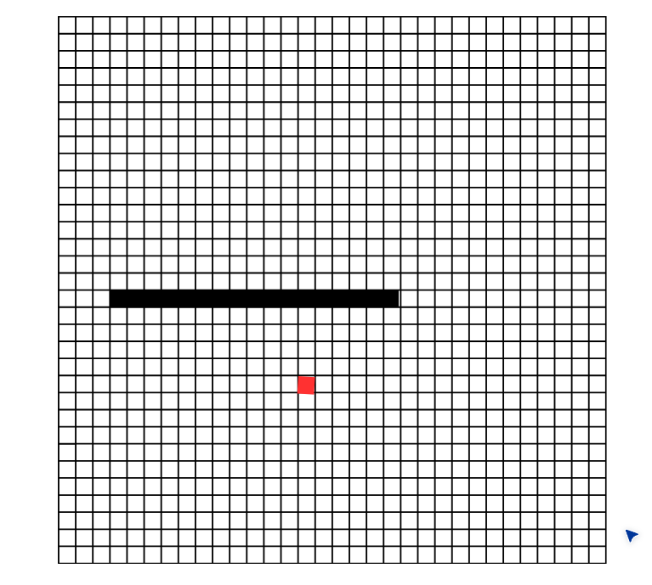
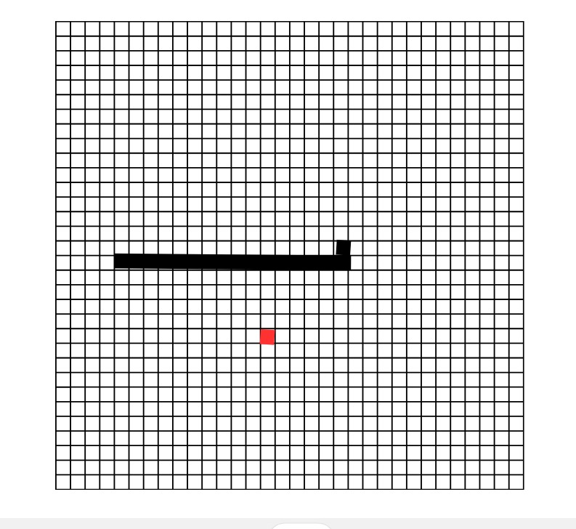
Nearest node in the RRT to a given point?

Slide 9
How did you extend the RRT towards a given point?
Snake movement algorithm:
Randomly generate a new position for the snake's head.
Move the snake's head one unit towards the goal state.
Repeat steps 1 and 2 until the snake reaches the goal.
Backtrack along the path to the current node and move the snake along this path in the real game.
Fruit generation:
After the snake eats the fruit, randomly generate a new fruit position. The snake's current position and the new fruit position become the new goal state.

Slide 10
Collisions between the snake's body and the game board?
At any instant of time, if two blocks of the snake's body occupy the same cell in the grid of the game, then there is a collision.
if the snake's head reaches out of bounds of the grid, then the game is finished.

Slide 11
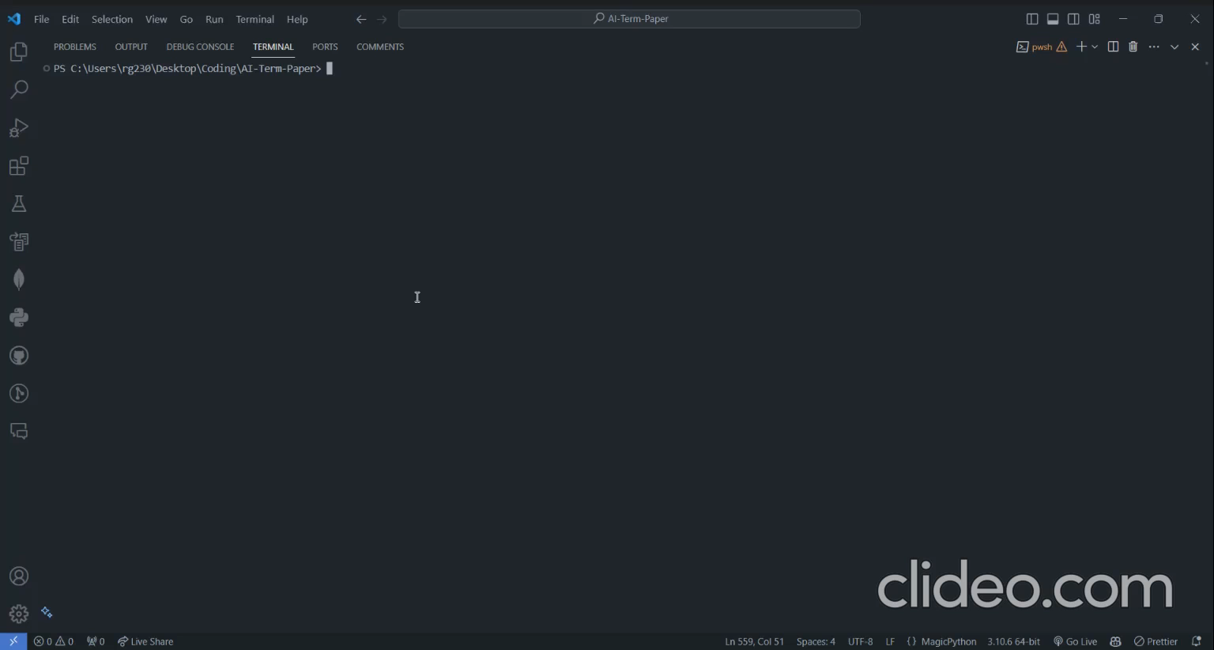
Demo

Slide 12
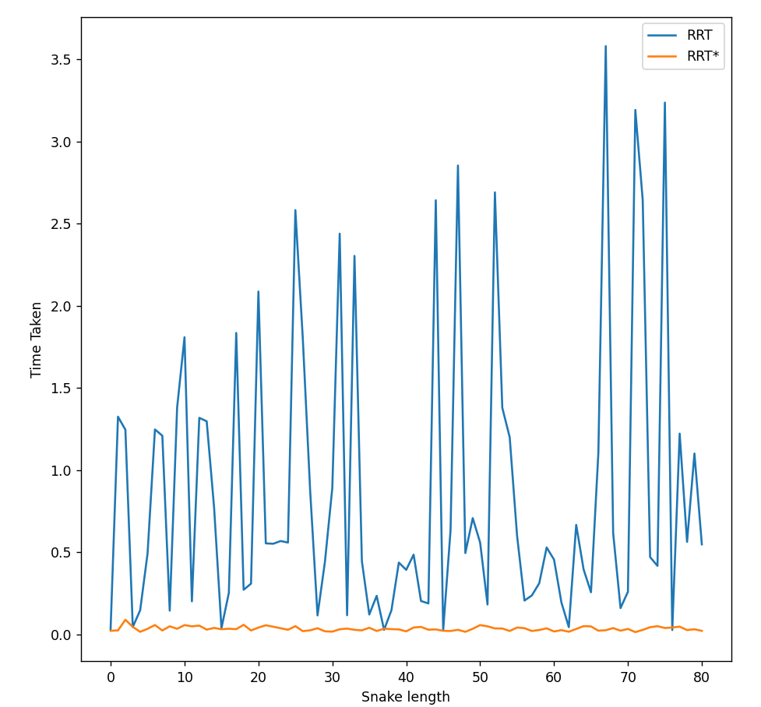
Result - 1 RRT vs RRT*
Analysis -
Cubic nature of graph in RRT*
Always maintaining the shortest path(RRT*)

Slide 13
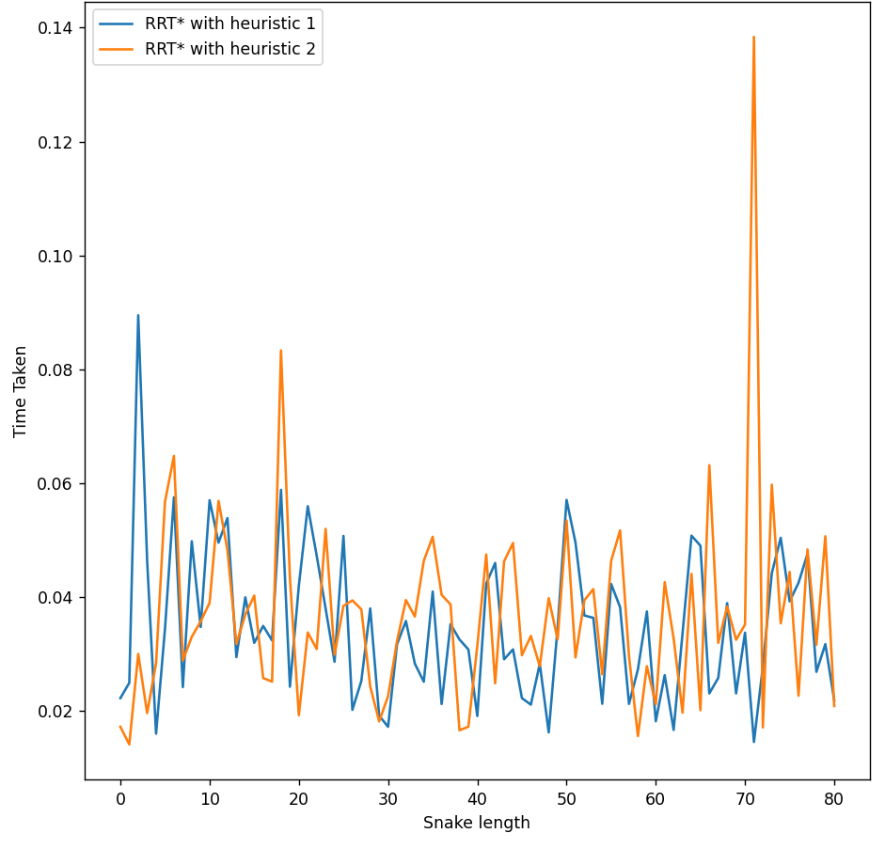
Result - 2 RRT* with different heuristics
Analysis -
1- Manhattan distance
2.- Euclidean distance

Slide 14
Sources and references –
https://youtu.be/OXikozpLFGo?si=U18EkBOOTul-iOdp
https://theclassytim.medium.com/robotic-path-planning-rrt-and-rrt-212319121378

